Slide 1
The three screen shots capture my login history on live.Microsoft.com between 4/19/2026 – 5/4/2026 On 4/25/2026 @ 5:45 PM, an unauthorized logging occurred from Washington DC on the Zayo Network.

Slide 2
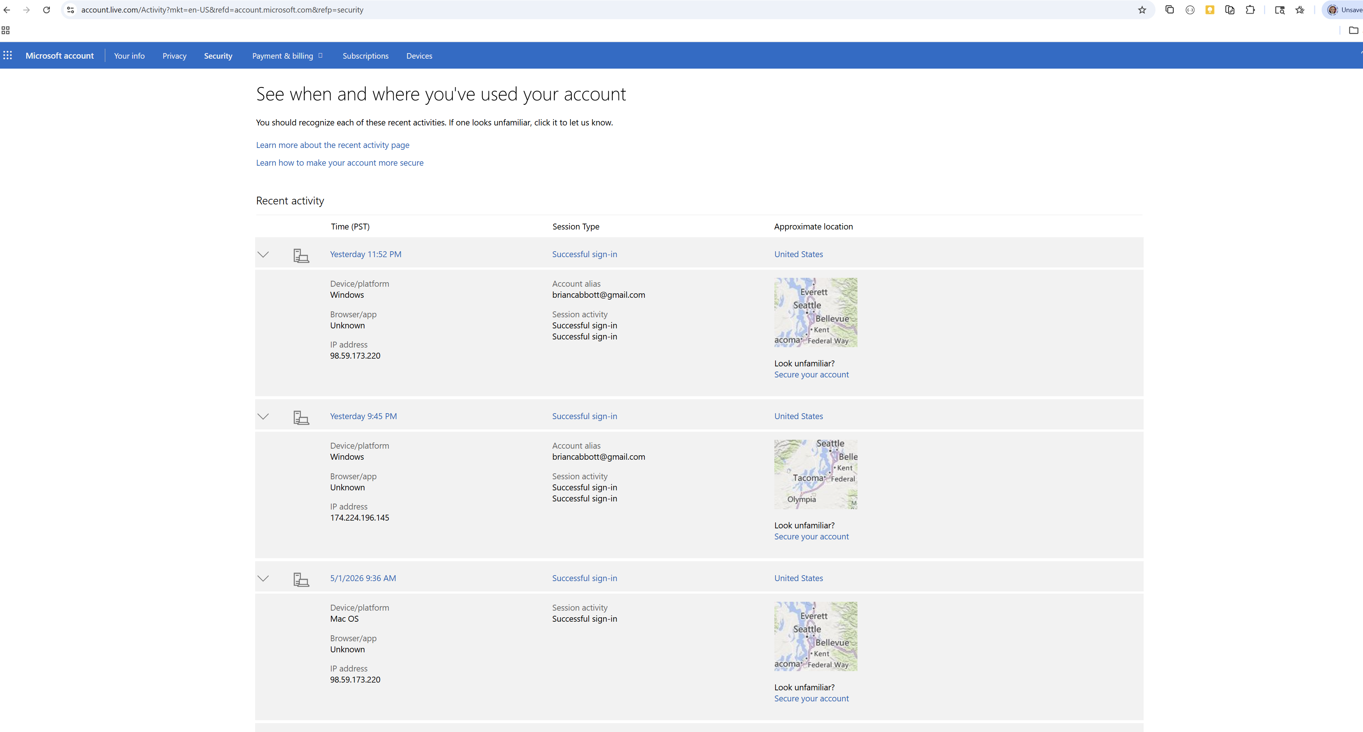

Slide 3
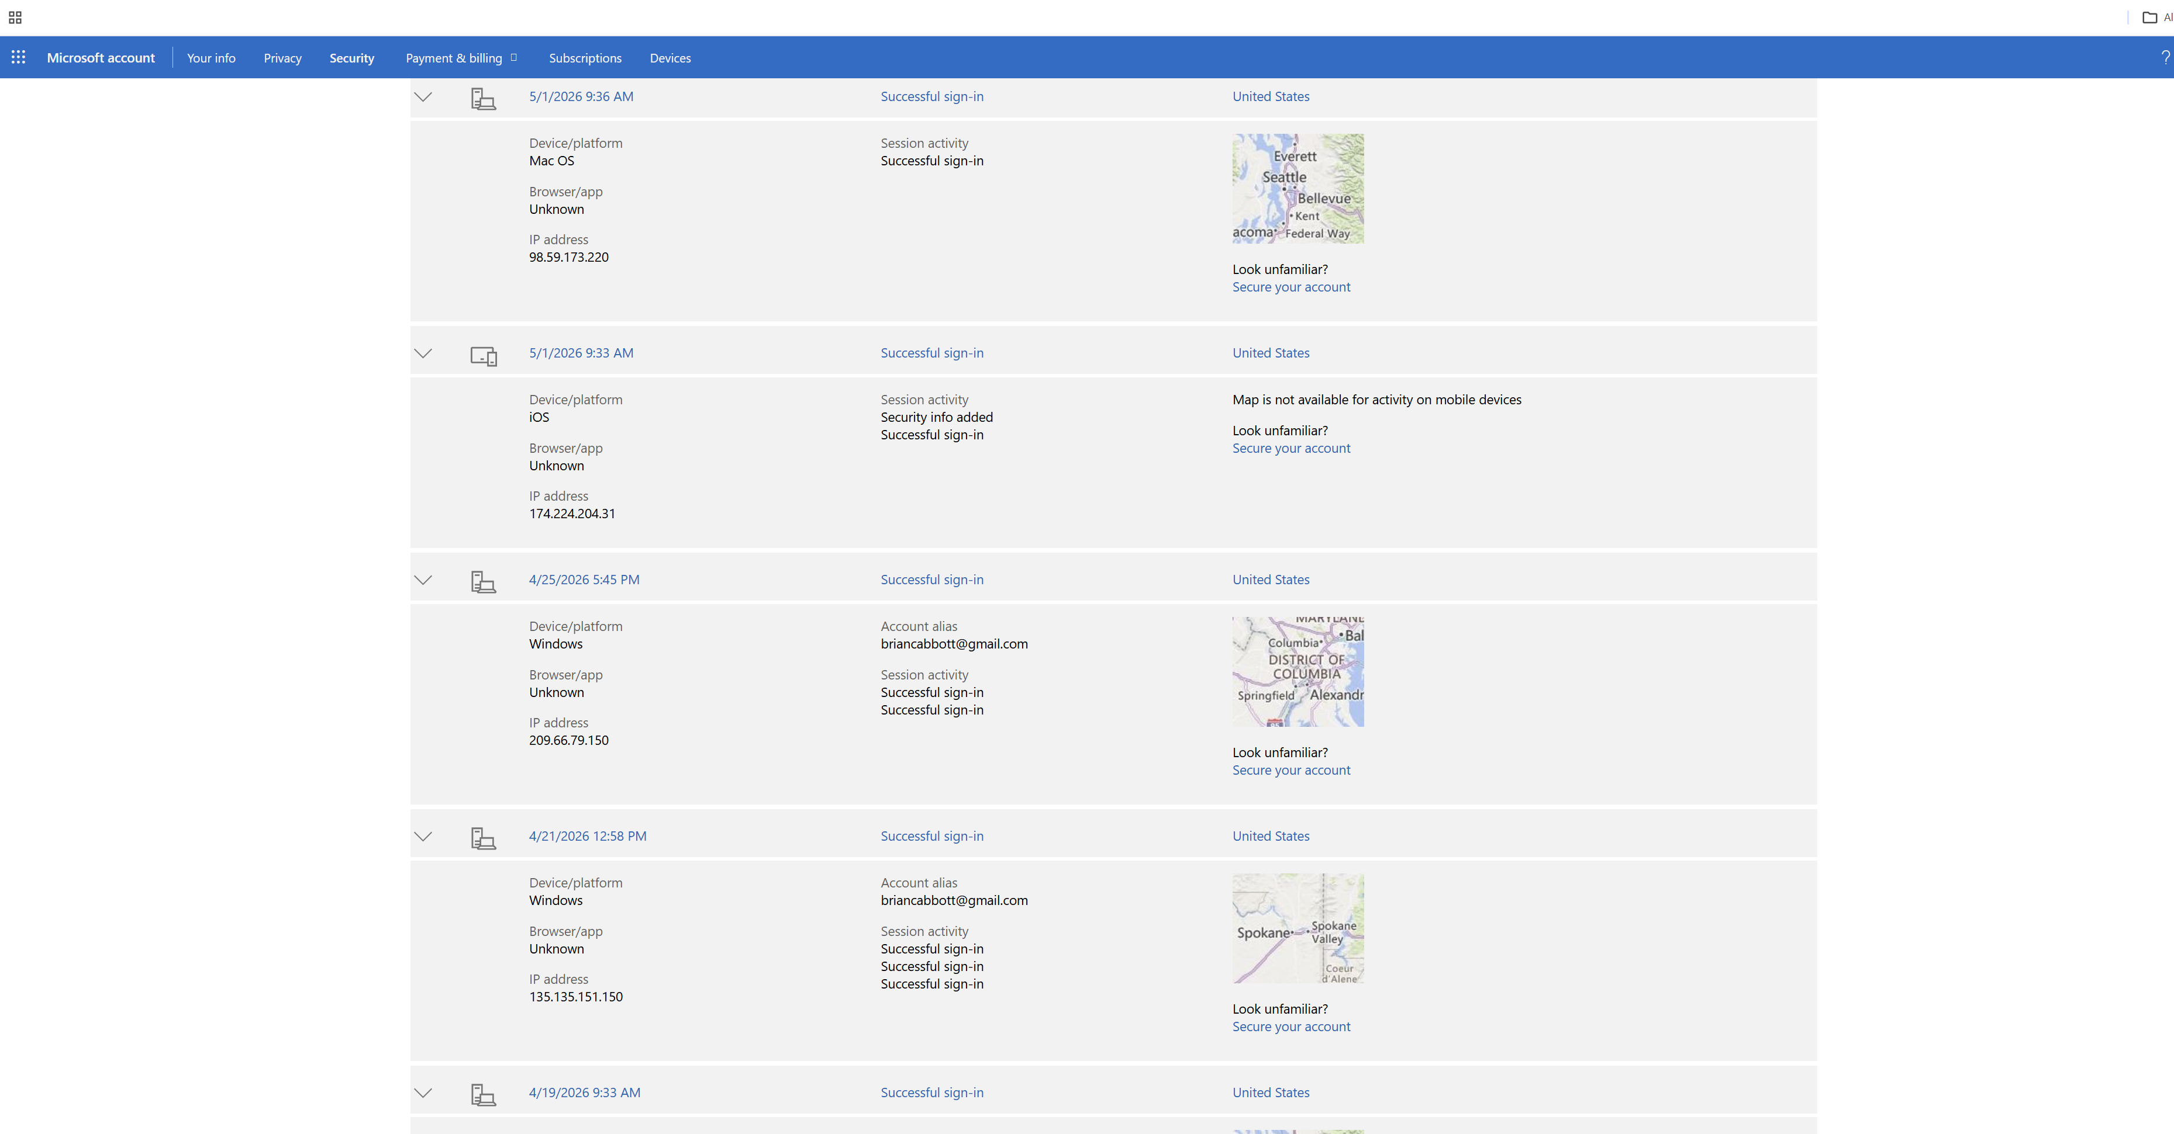

Slide 4
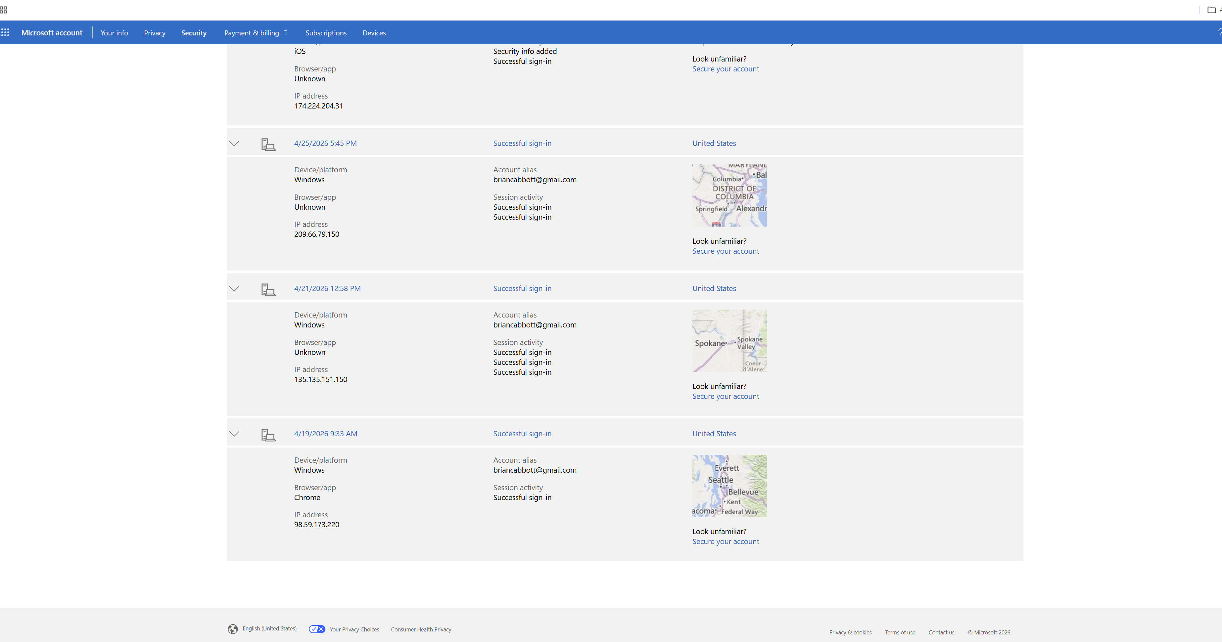

Slide 5
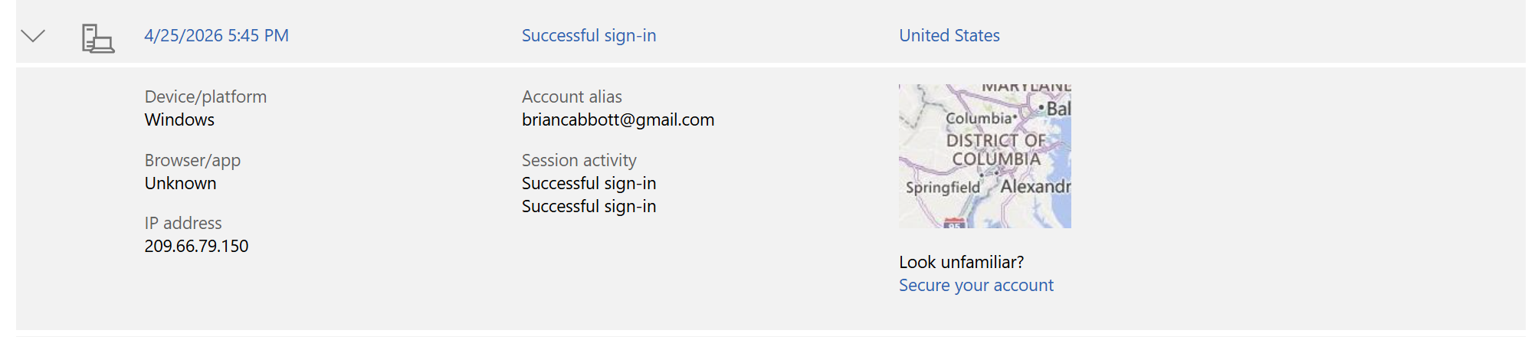
This login was not from me.

